Slide 1
VISAR Calibration
EuXFEL 2740: Dipole commissioning

Slide 2
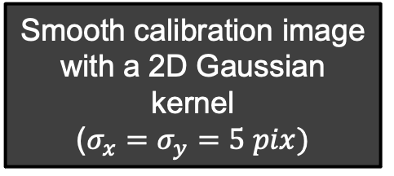
Flowchart of the dewarp procedure
Smooth calibration image with a 2D Gaussian kernel
($σ_{x}=σ_{y}=5 pix)$
Fit 6th order polynomial to each column and line
Refine peak position
Define warp grid as intersection of fitted lines and columns
Find position of each peak
Order peaks by columns and lines
Linear mapping between warp grid and dewarp grid
Refine position by computing the center of mass of each peak (binary image corresponding to 80% maximum intensity)
Find spacing between adjacent peaks closest to the center of distortion
Define dewarp grid

Slide 3
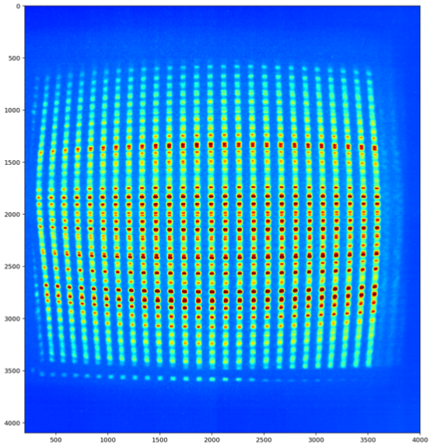
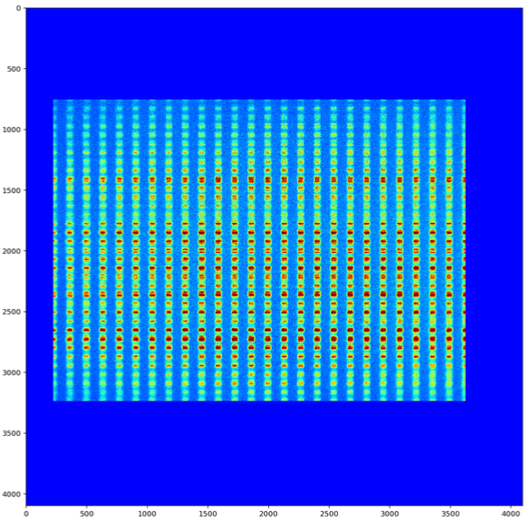
Results of the dewarp procedure on the spatio-temporal calibration image
KEPLER2 – r1222
ON 250 PS - OFF 500 PS

Slide 4
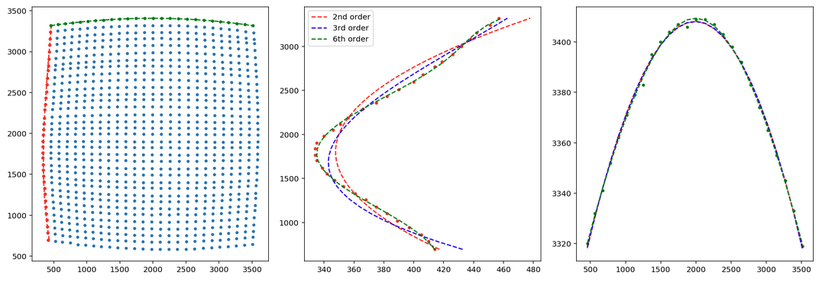
Polynomial fits to the columns and rows of the calibration image
KEPLER2 – R1222 – 20 ns sweep window
ON 250 PS - OFF 500 PS
Points from spatio-temporal calibration
Column
Row
Calibration rows/columns are fitted using 6th order polynomial to remove high spatial frequency variations (6th order lowest order than qualitatively goes through all calibration points).
Refined calibration points constructed from intersection of fitted rows and columns.

Slide 5
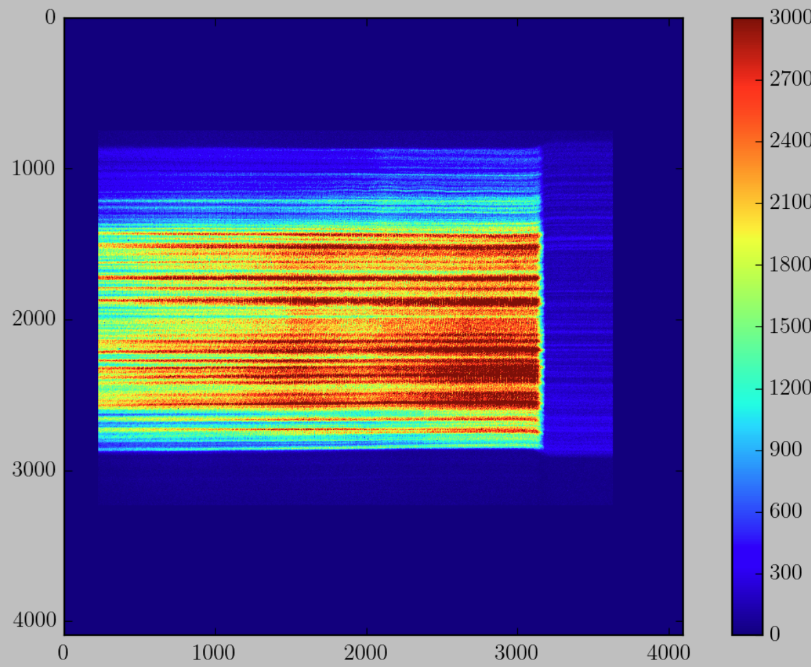
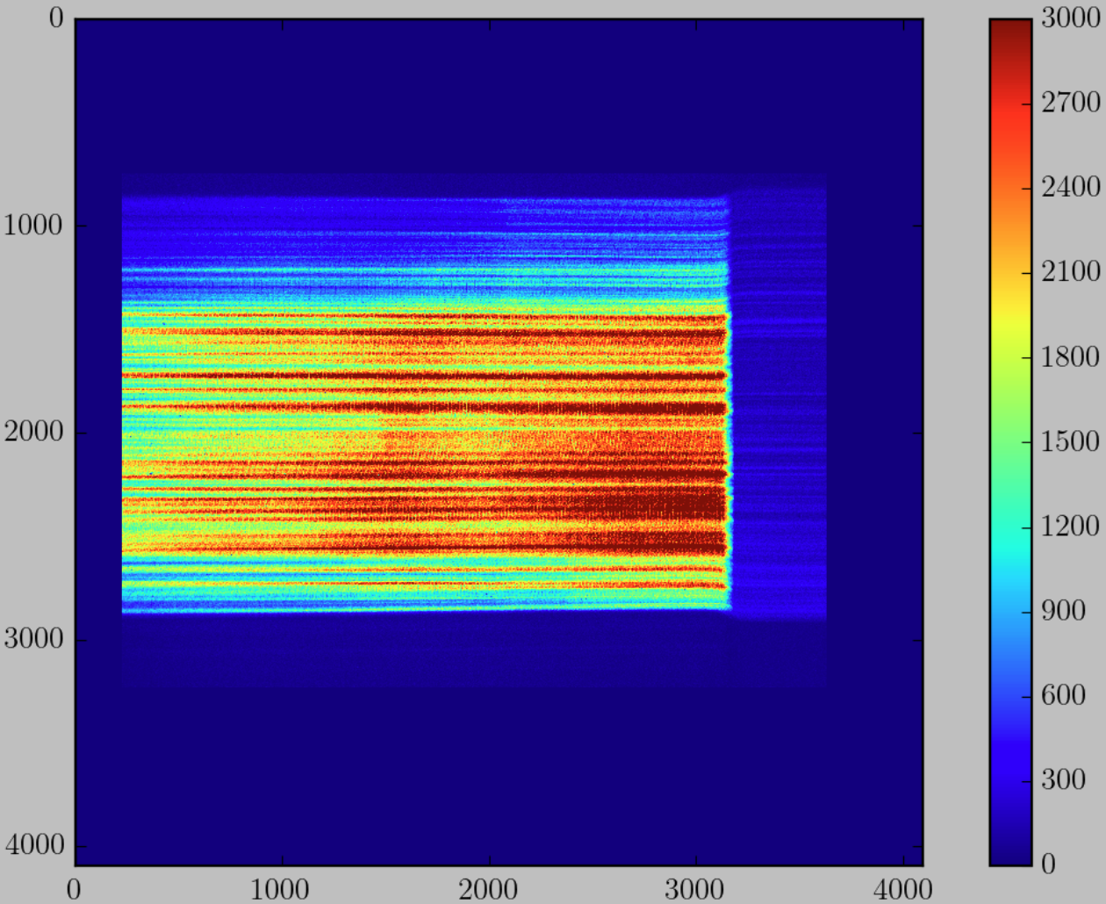
Improvement on the previous dewarp calibration file
Dewarp image
without polynomial fitting
(KEPLER1)
Dewarp image
with polynomial fitting
(KEPLER1)
Remove rapid oscillations in the fringes with the polynomial fitting
Not as sensitive to the fitted position of the points in the calibration image

Slide 6
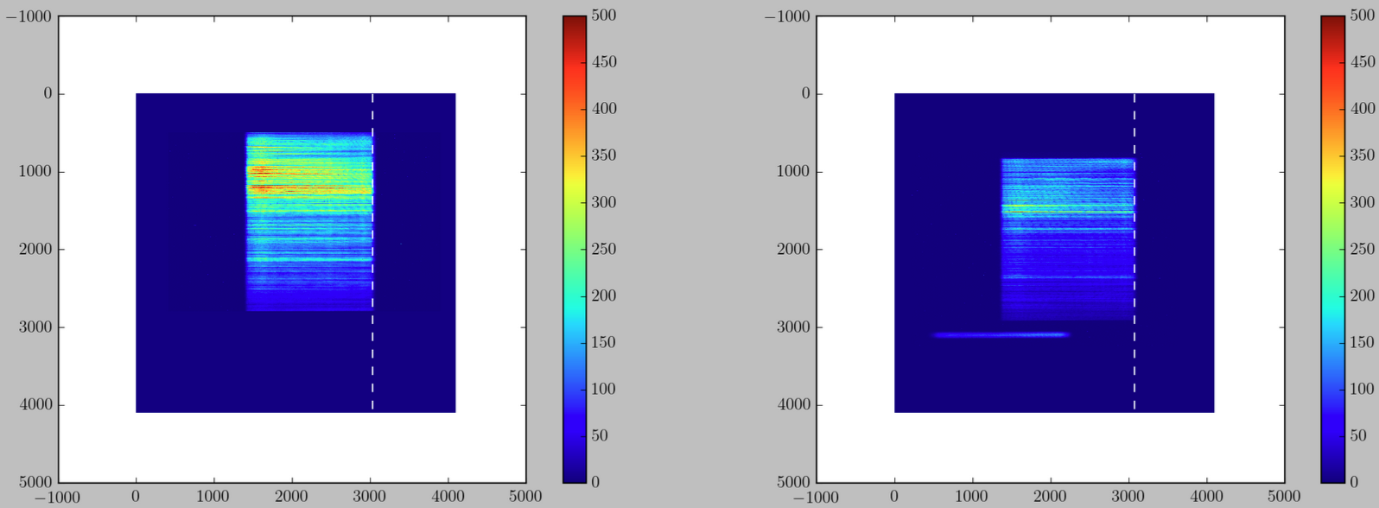
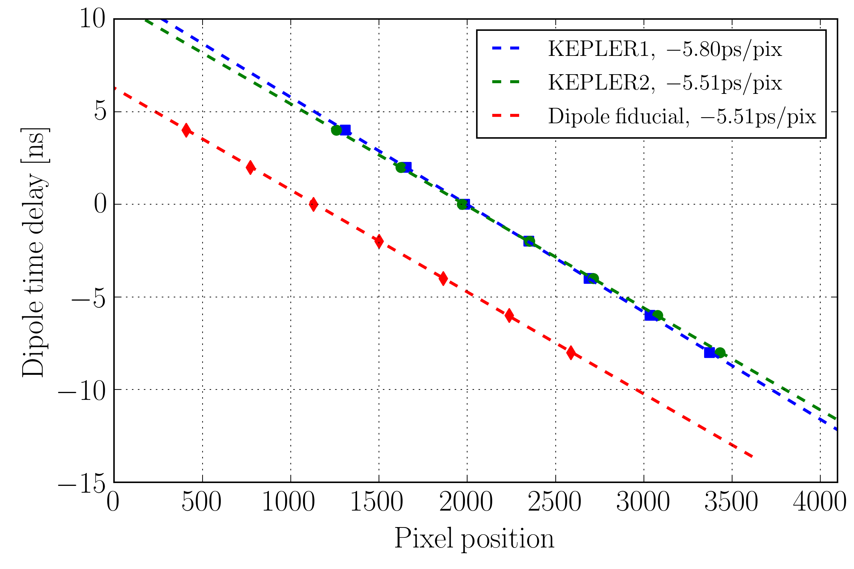
Calibration time axis for 20 ns sweep window
KEPLER1
Change time delay of dipole and track the pixel position of the right edge
KEPLER2
20 ns sweep window
10 ns square pulse
In this images time goes right to left.
The calibration values are given for time flowing left to right.

Slide 7
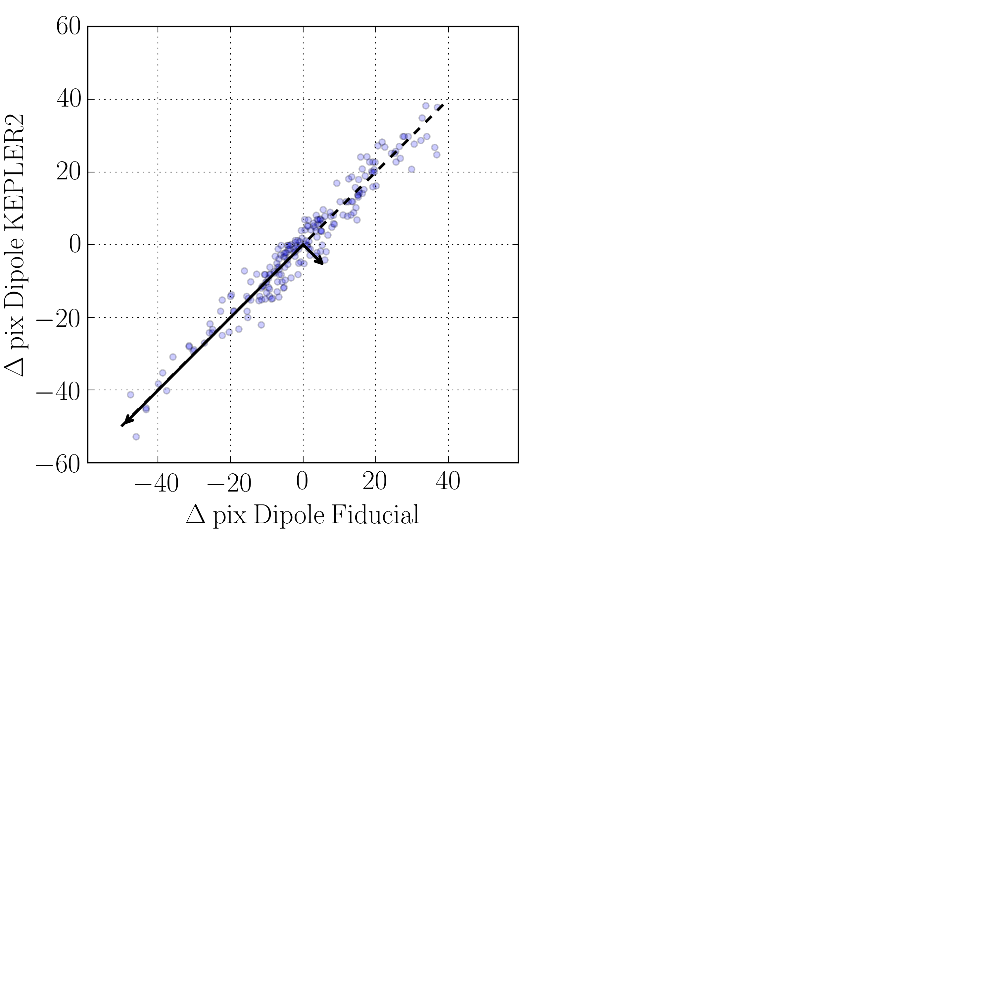

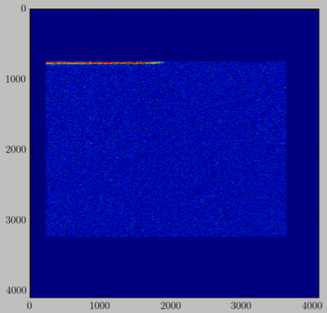
Temporal jitter
Jitter of the edge of X-ray
fiducial on KEPLER2 (r669)
Edge position of dipole vs the dipole fiducial on KEPLER2
Jitter of the edge of the dipole fiducial on KEPLER2
X-ray fiducial edge
15 ps
20 ps
130 ps
130 ps
Timing jitter of the X-ray with respect to KEPLER2: 95 ps
Dipole fiducial and dipole rising edge move together on streak
(regardless if dipole or the streak moves in time)
Jitter of the dipole AND streak combined: 130 ps
Accuracy of rising edge finding: 15 ps
Dipole jitter moves the rising edge of dipole by the same amount on both streaks.
Jitter of the dipole AND streak combined: 130 ps
In practice jitter in the orthogonal direction would give the jitter between the both streaks. Here the measurement is limited by the accuracy of finding the rising edge
Timing jitter streak: 95 ps
Dipole jitter: 90 ps (Dipole and Streak jitter assumed independent)

Slide 8
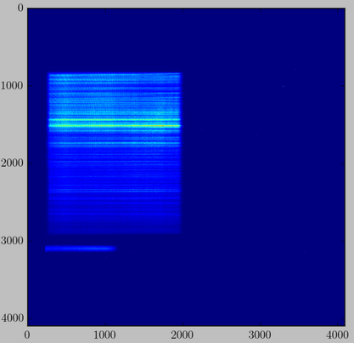
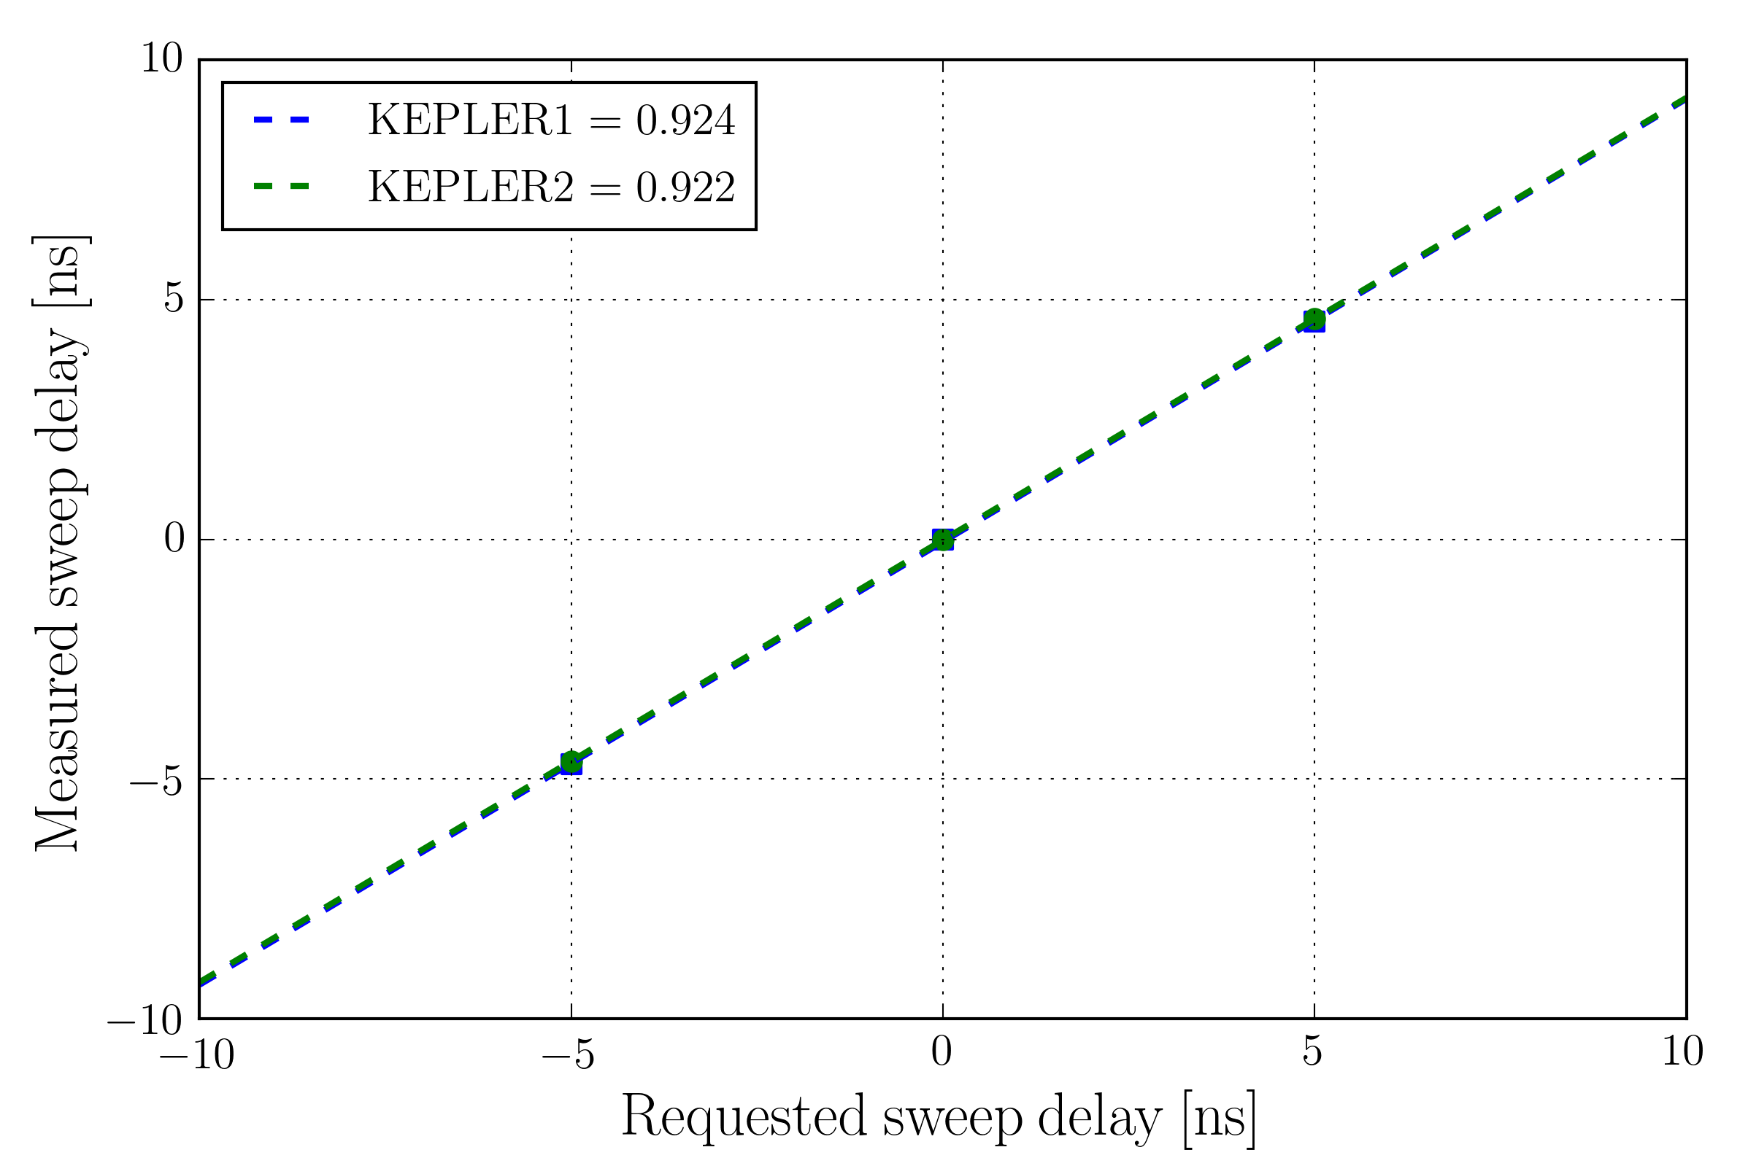
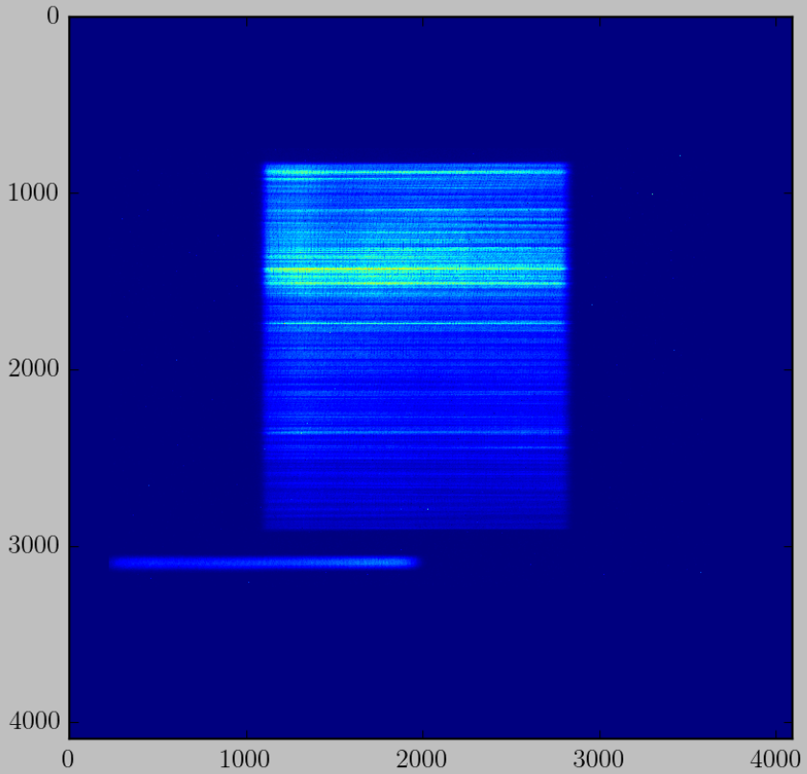
Calibration sweep window delay for 20 ns sweep window
Dipole arrives at 0 ns time delay and we move the sweep windows
r641
Dipole: 0 ns delay
Sweep: 0 ns delay
r652
Dipole: 0 ns delay
Sweep: “-5 ns” delay
Sweep window does not move by the requested amount!

Slide 9
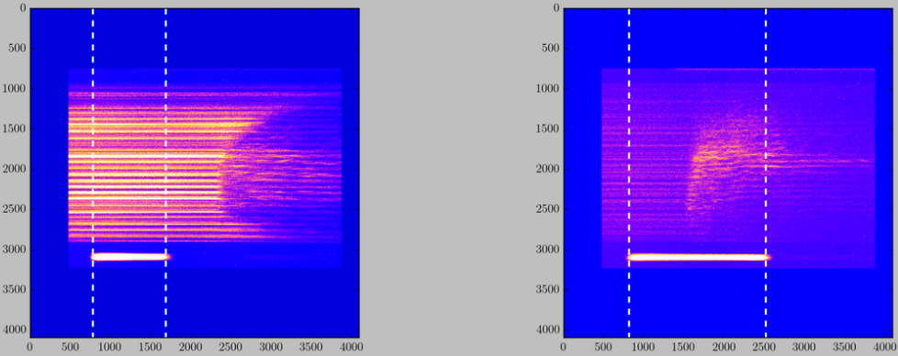
Dipole pulse duration measured using the fiducial on KEPLER2
r857
r869
4.99 ± 0.02 ns
9.37± 0.02 ns
20 ns sweep
5 ns square pulse
20 ns sweep
10 ns square pulse
Uncertainty calculated using 13 runs available
Uncertainties calculated using 45 runs

Slide 10
Summary time calibration 20 ns sweep window
Pixel positions are given for a 4096x4096 image.
If using a downsampled image, all the pixel values need to be divided by the downsampling ratio (for 1024x1024 image, all pixel values need to be divided by 4).
 | KEPLER1 | KEPLER2
Time calibration [ps/pix] | 5.80 [using r641-647] | 5.51 [using r641-647]
Scaling dipole delay (measured vs requested) | 0.999 [using r641-647] | 1.0 [using r641-647]
Scaling sweep delay (measured vs requested) Between -5 ns and 5 ns | 0.924 [using r641, r652, r653] | 0.922 [using r641, r652, r653]
Pixel position dipole at 0 ps delay | 2111 [using r641] | 2126 [using r641]
Pixel position dipole fiducial at 0 ps delay | No fiducial | 2969 [using r641]
Pixel position X-ray | 2078 [using r668-670] | 2117 [using r668-670]
Pixel position X-ray fiducial | No fiducial | 2244 [using r669]

Slide 11
Summary time calibration 50 ns sweep window
Pixel positions are given for a 4096x4096 image.
If using a downsampled image, all the pixel values need to be divided by the downsampling ratio (for 1024x1024 image, all pixel values need to be divided by 4).
 | KEPLER1 | KEPLER2
Time calibration [ps/pix] | 14.56 [using r650-651] | 14.39 [using r650-651]
Pixel position dipole at 0 ps delay | 2069 [using r650] | 2018 [using r650]
Pixel position dipole fiducial at 0 ps delay | No fiducial | 2355 [using r650]
Pixel position X-ray | 2056 [calculated from 20 ns calibration] | 2014 [calculated from 20 ns calibration]

Slide 12
Summary time calibration 10 ns sweep window
Pixel positions are given for a 4096x4096 image.
If using a downsampled image, all the pixel values need to be divided by the downsampling ratio (for 1024x1024 image, all pixel values need to be divided by 4).
 | KEPLER1 | KEPLER2
Time calibration [ps/pix] | 2.81 [using r648-649] | 2.67 [using r648-649]
Pixel position dipole at 0 ps delay | 2045 [using r648] | 2169 [using r648]
Pixel position dipole fiducial at 0 ps delay | No fiducial | 2637 [using r649]
Pixel position X-ray | 1977 [calculated from 20 ns calibration] | 2150 [calculated from 20 ns calibration]

Slide 13
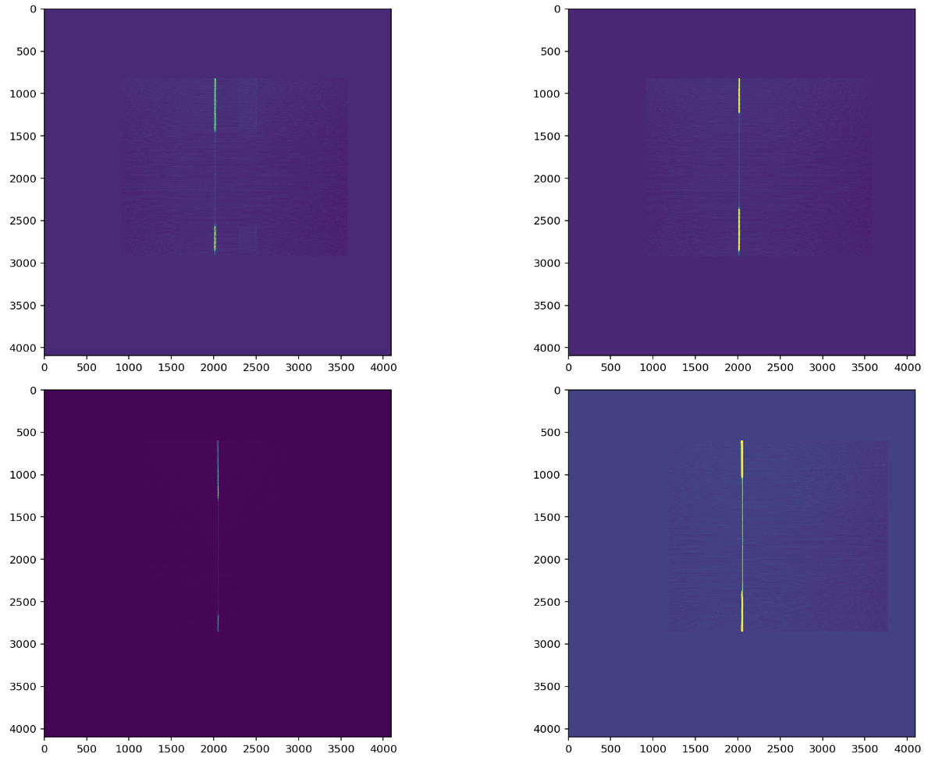

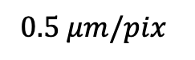
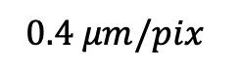

Spatial calibration
$$100 μm$$
$$0.4 μm/pix$$
KEPLER1
$$0.5 μm/pix$$
$$100 μm$$
KEPLER2

Slide 14
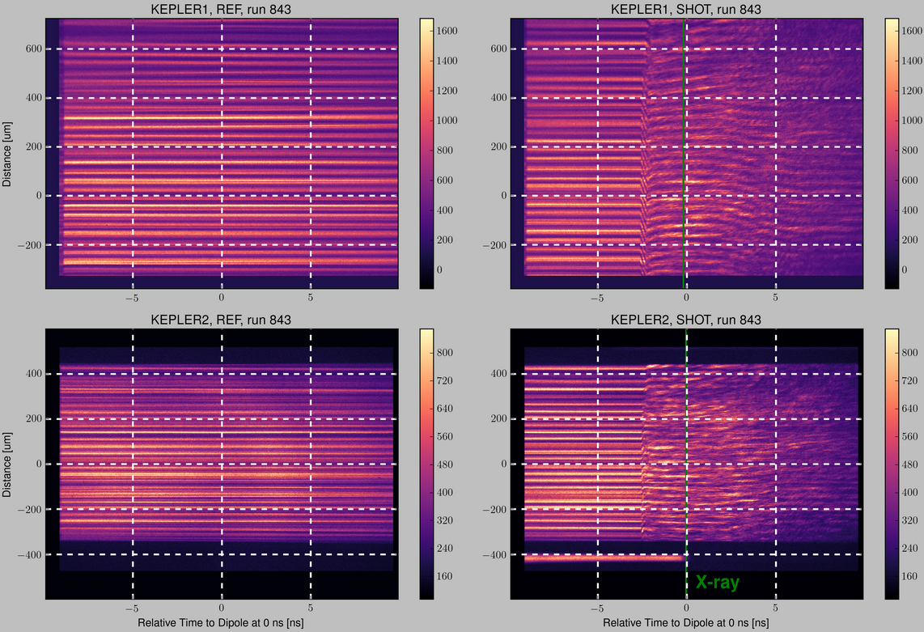
Example of single shock on silicon

Slide 15
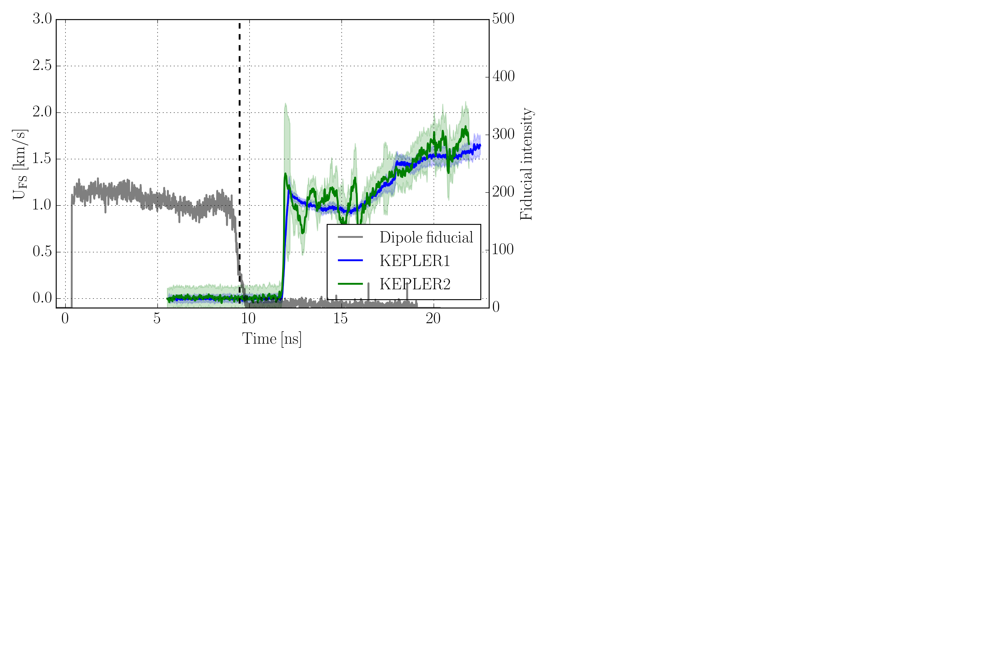
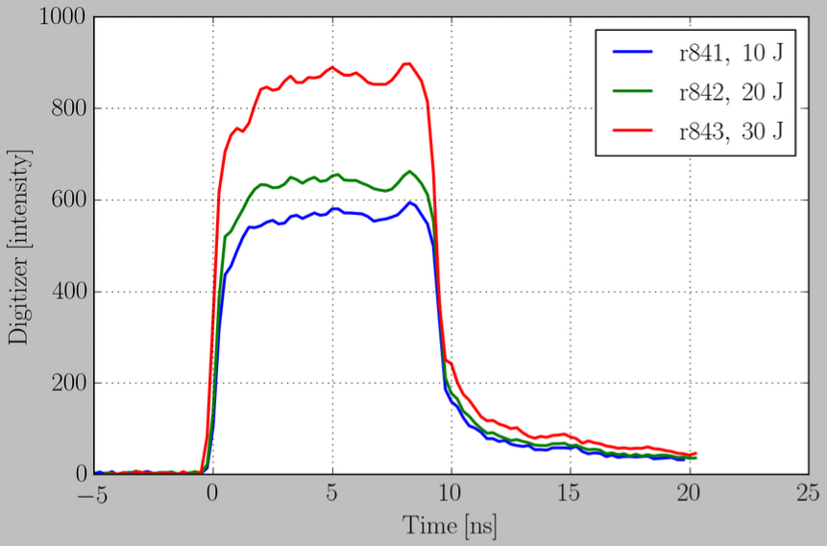
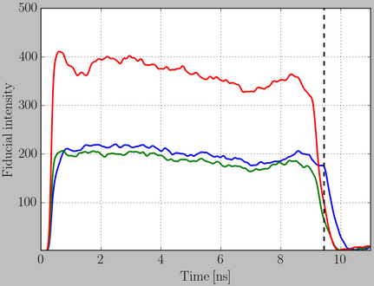
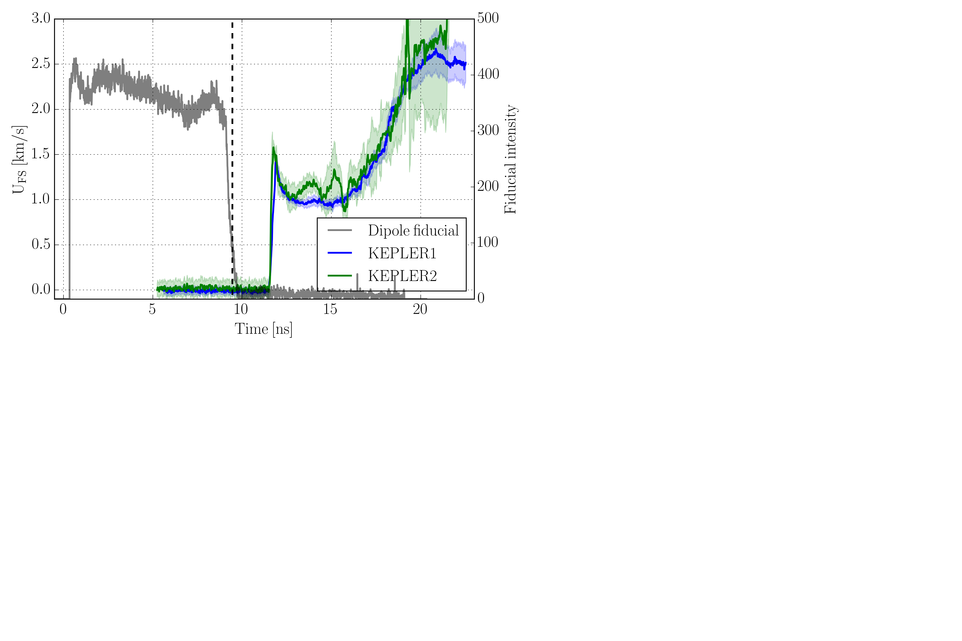
Velocity history single shock on silicon
Sweep delay: “5 ns” (4.61 ns)
Sweep window: 20 ns
Pulse shape: nominally 10 ns square
(don’t see the rising edge of the fiducial – outside the streak window)
r842
Dipole energy: 19 J
Dipole delay: 9.5 ns
X-ray timing
From digitizer
From Dipole fiducial
Is it possible to calibrate one of these two diagnostics (or both) against Dipole energy?
Important to accurately measure the energy in the pulse for more complicated pulse shapes
r843
Dipole energy: 28.8 J
Dipole delay: 9.5 ns

Slide 16
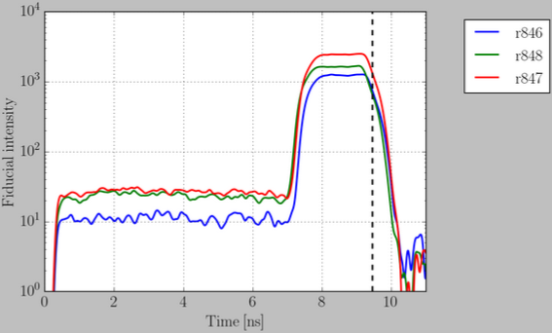
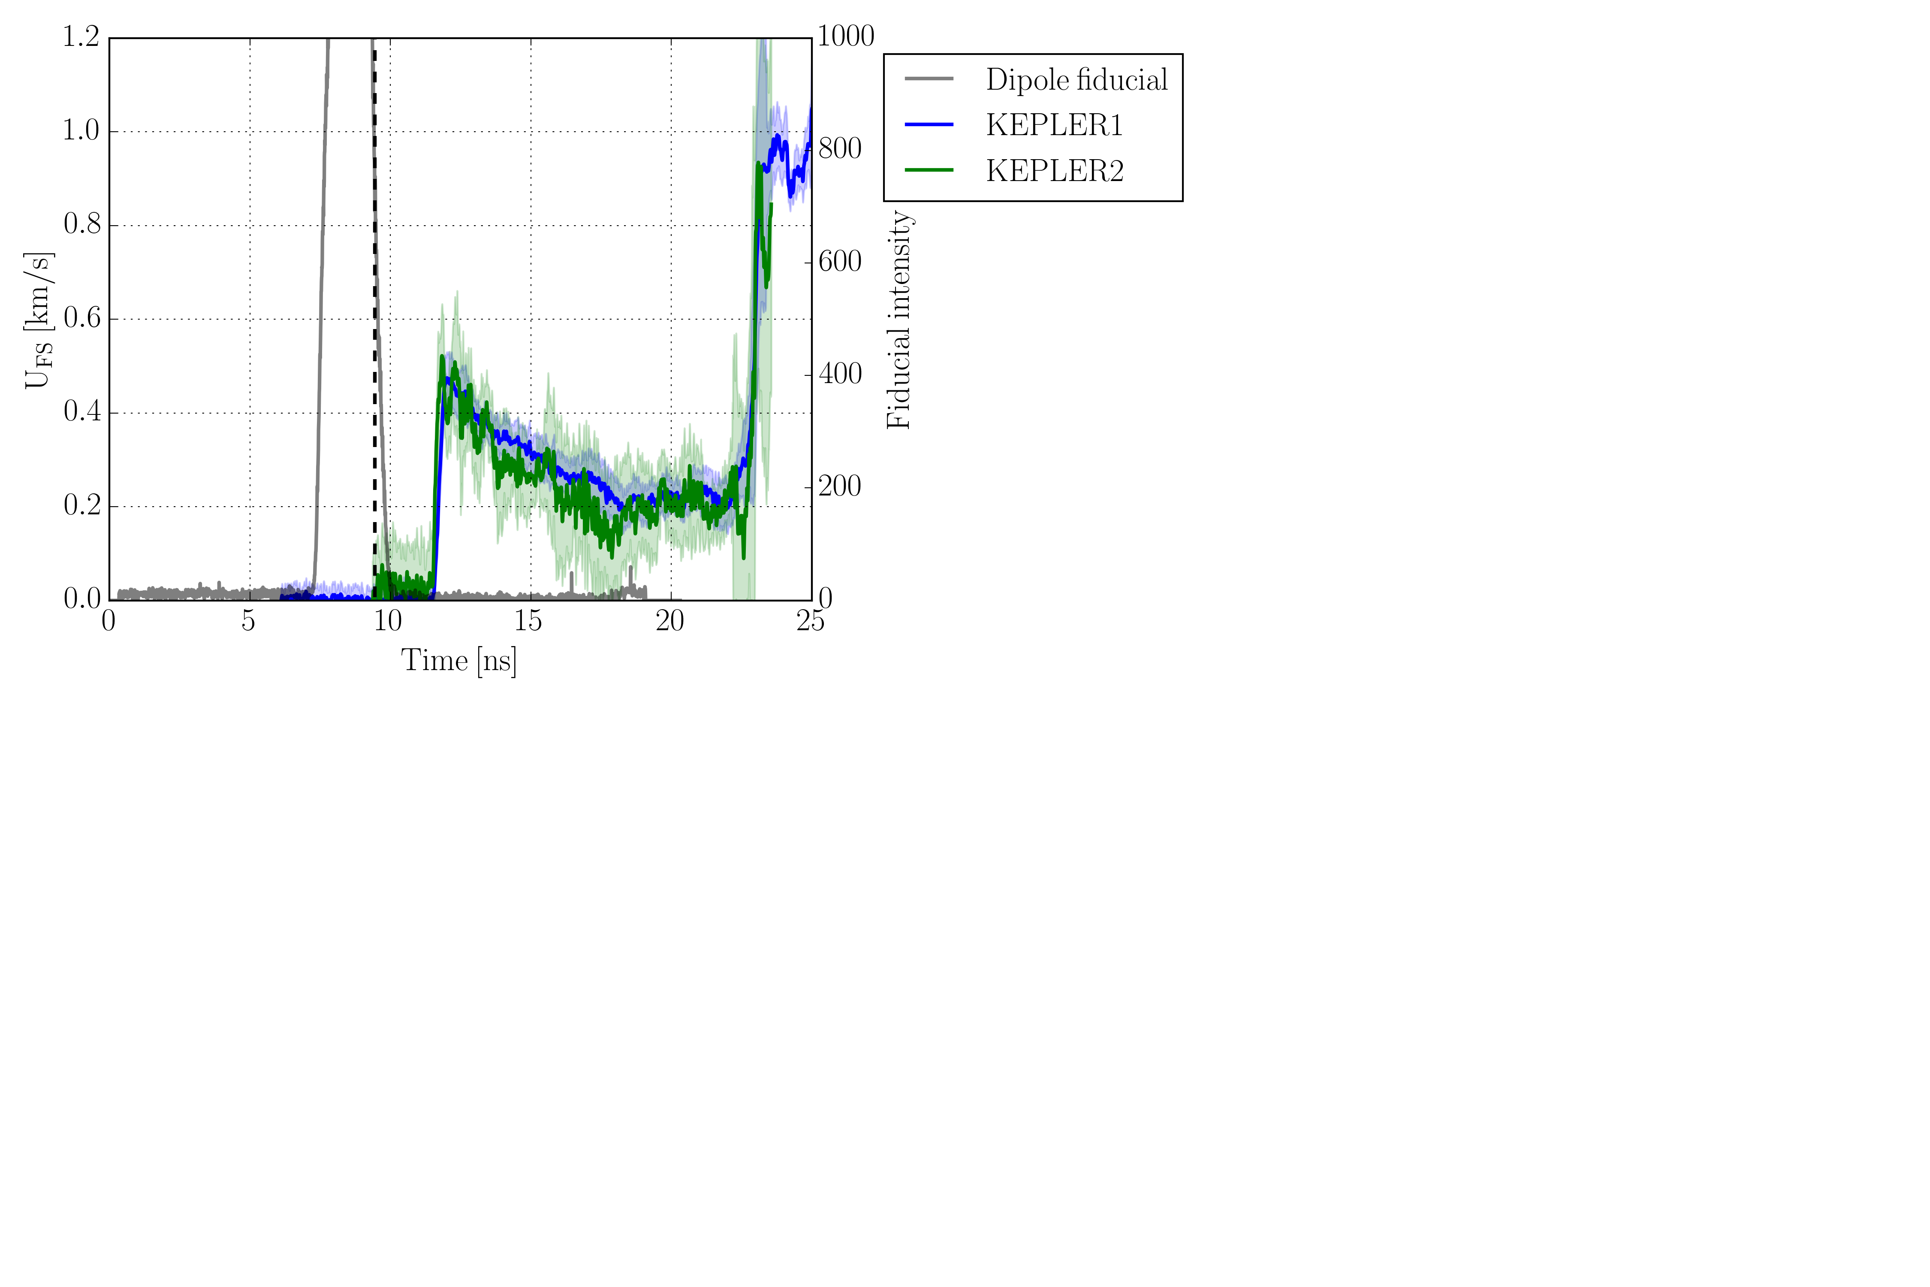
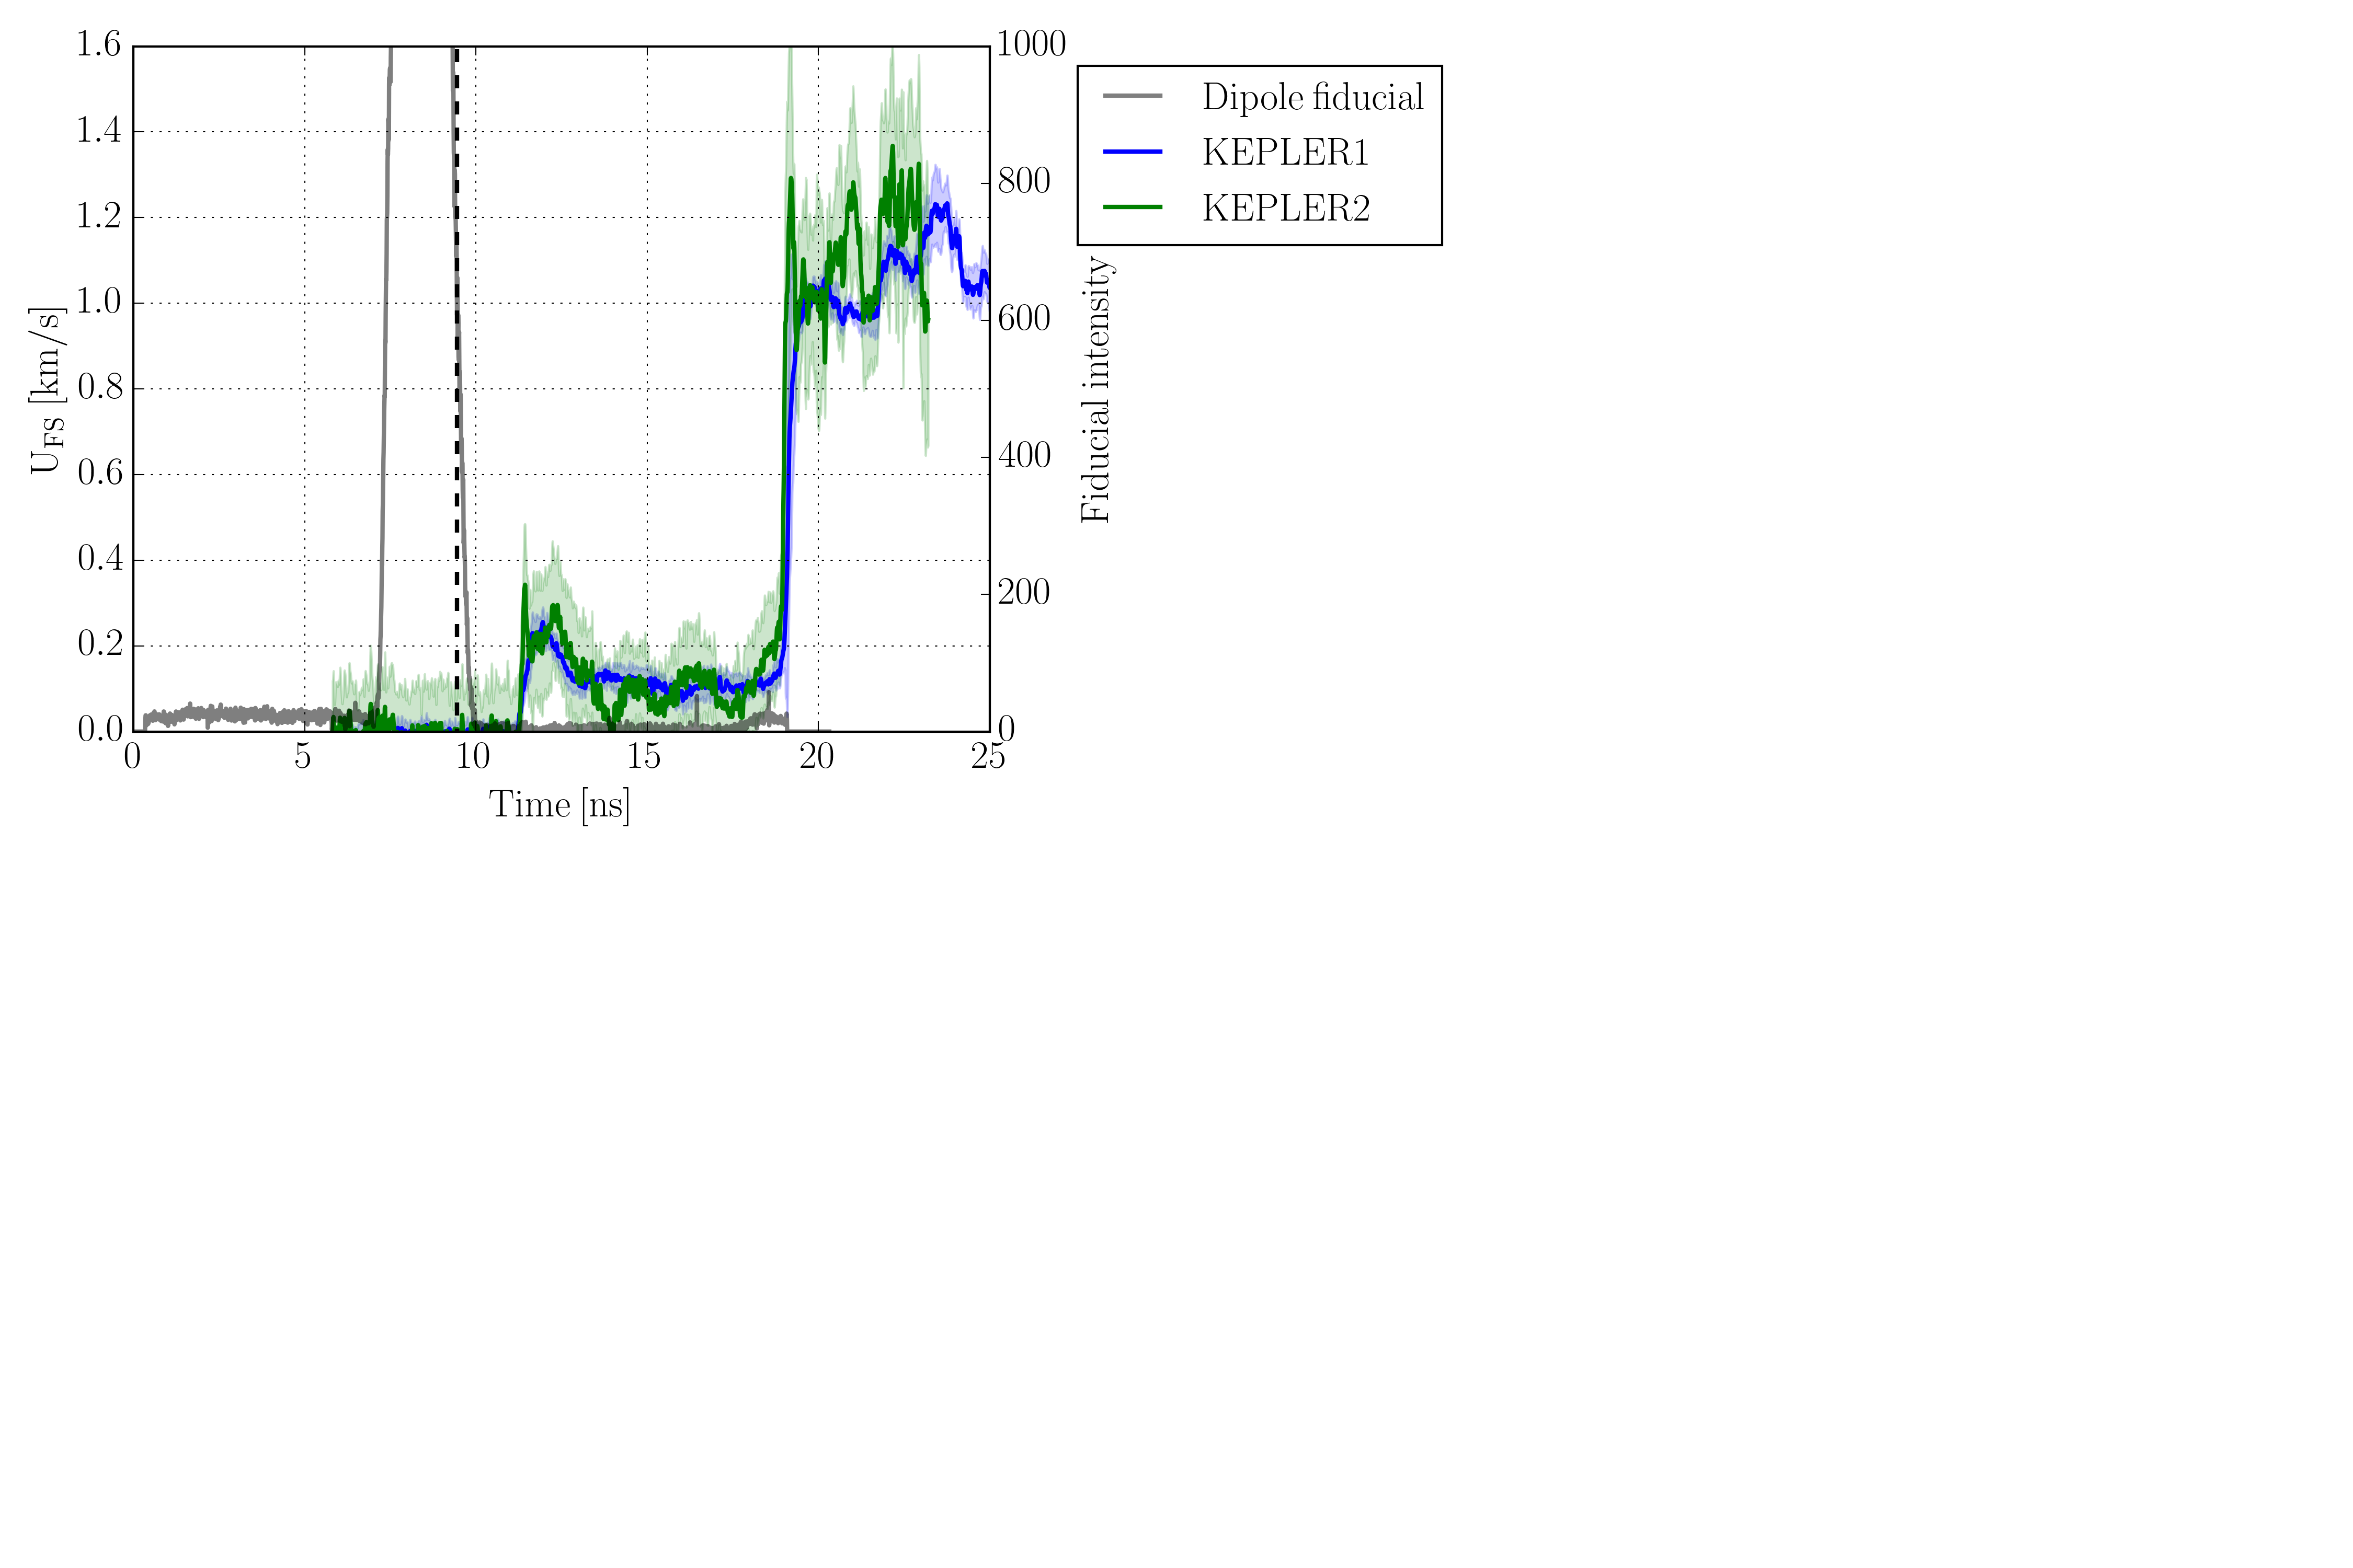
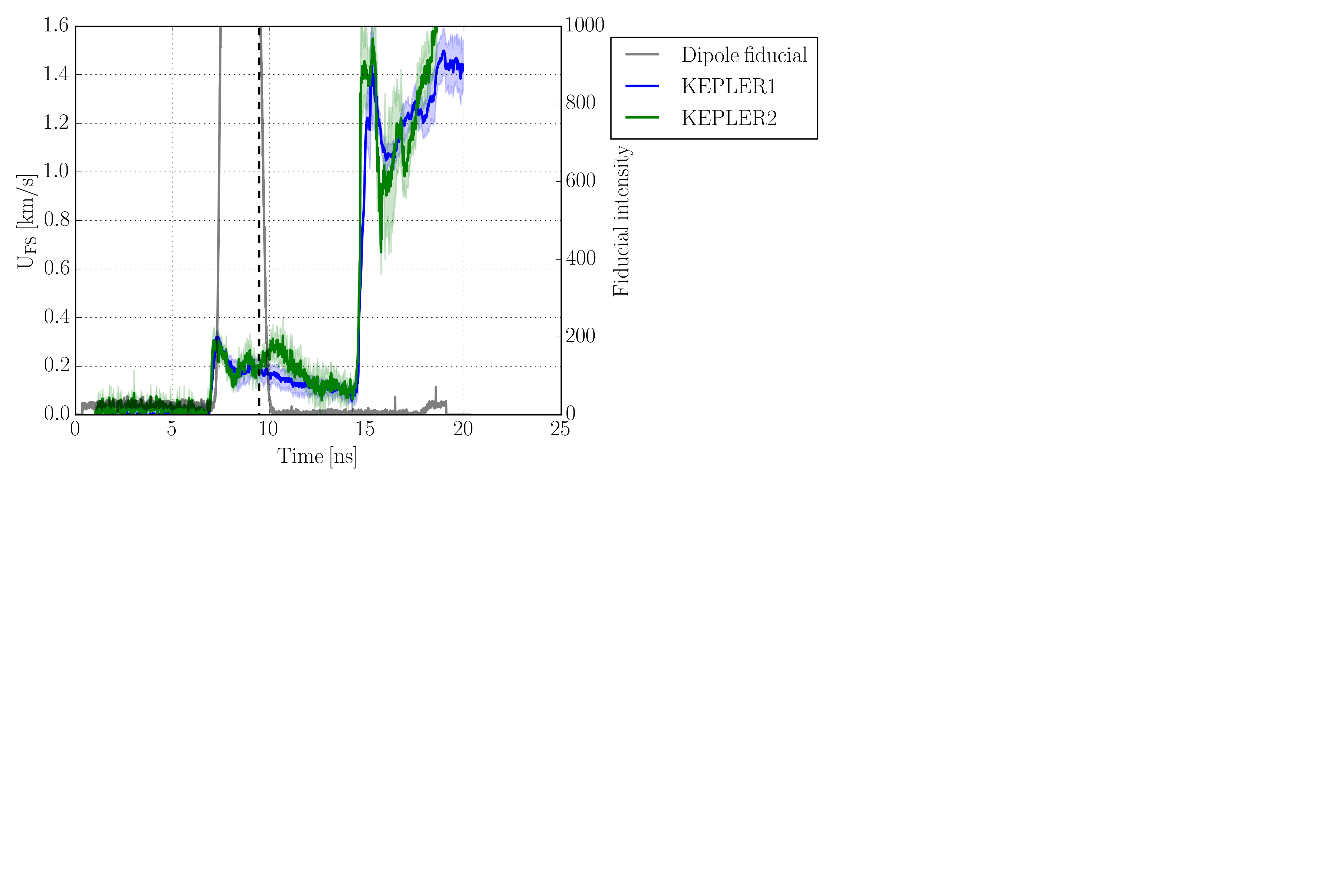
Velocity history double shock on silicon
8 ns pedestal + 2 ns square
1:10 intensity
r846
Dipole energy: 6.4 J
Dipole delay: 9.5 ns
x100
r848
Dipole energy: 9.6 J
Dipole delay: 9.5 ns
Accounting for pulse duration of the pedestal ~ 7 ns
Double shock is more like 1:30 intensity
r847
Dipole energy: 13.6 J
Dipole delay: 9.5 ns

Slide 17
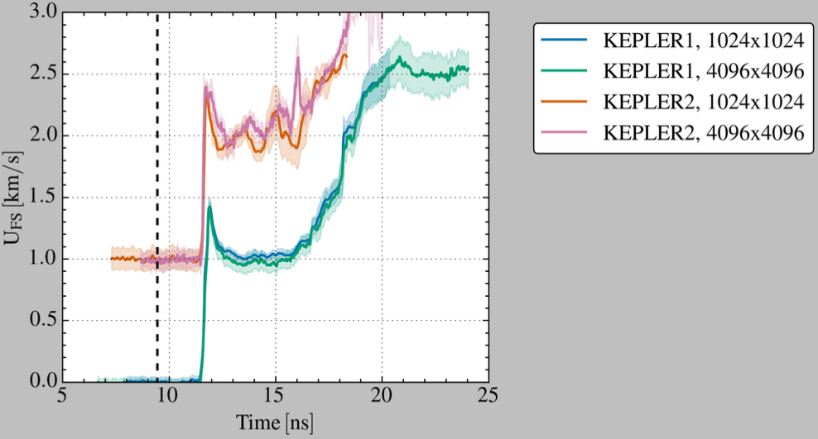
Impact of down-sampling VISAR images
r843
Dipole energy: 28.8 J
Dipole delay: 9.5 ns

